Slide 1
Customizing Papyrus-RT for Model-Driven Development of Rover Software
Supervised By: Dr. Juergen Dingel
Sudharshan Gopikrishnan, Nicolas Hili
Queen’s School of Computing

Slide 2
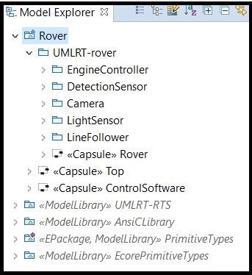
The Problem ??

Slide 3

Problem Statement
?
How to change or verify the design configurations with ease ?

Slide 4

Motivation Solution
✓
Embedding a specific configuration page with the loaded library
Providing an unique user experience when designing the Rover Model

Slide 5
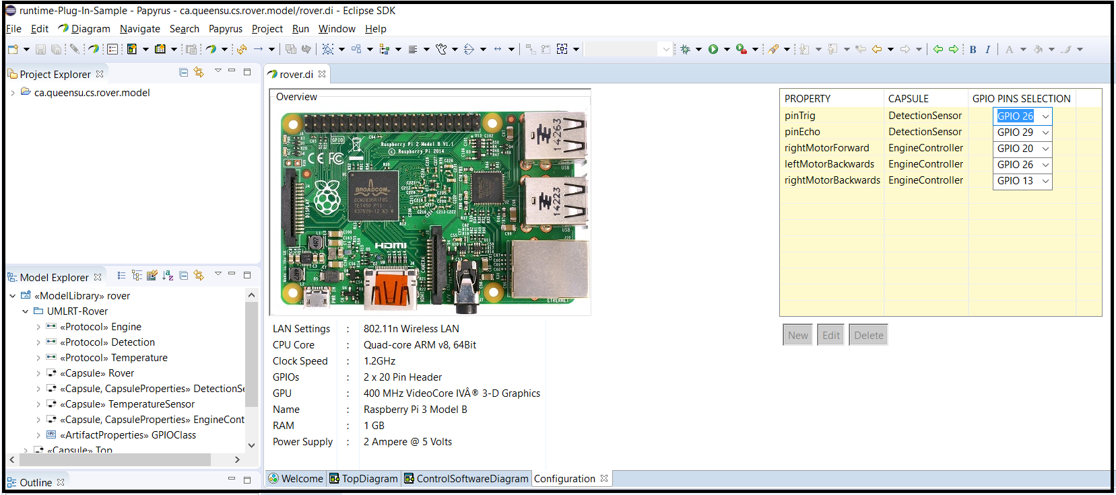
Six Months Ago ..
UML-RT Package loaded in the model
Allow for editing the design configuration (i.e., the GPIO mapping)
Configuration Page
Platform Overview
Notes:
The current implementation of the project

Slide 6
Since Then ..
Providing a base Rover template within Papyrus-RT
Creating component specific configuration pages
Dynamically creating & disposing new tabs within the configuration page depending on the loaded package
And Many More !!!

Slide 7
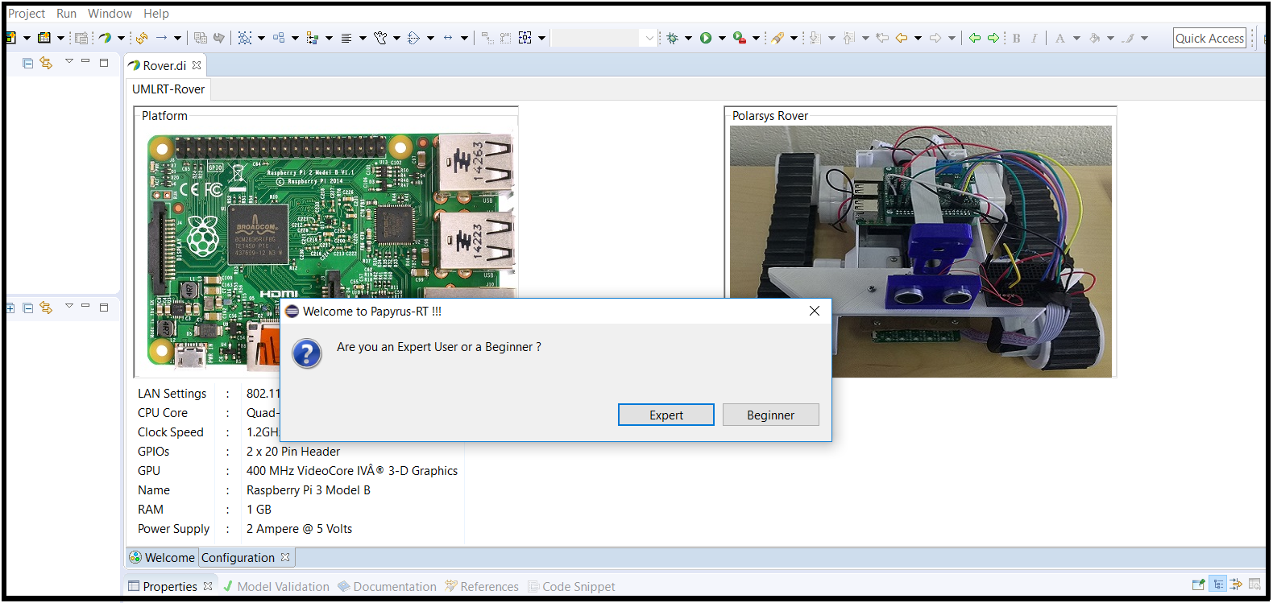
Current Implementation

Slide 8
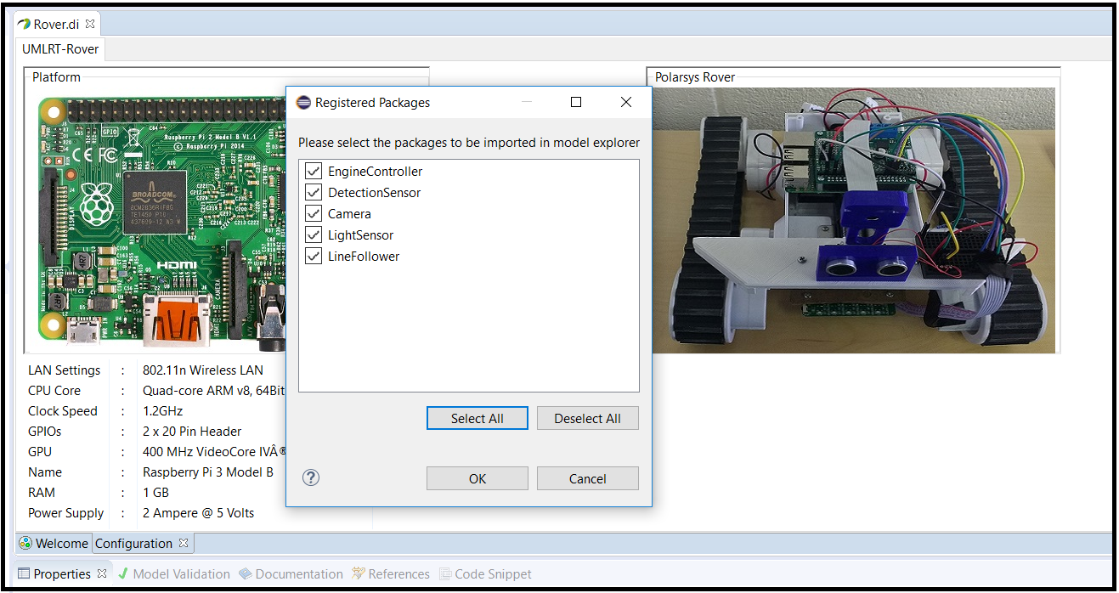
Current Implementation – Expert Mode

Slide 9
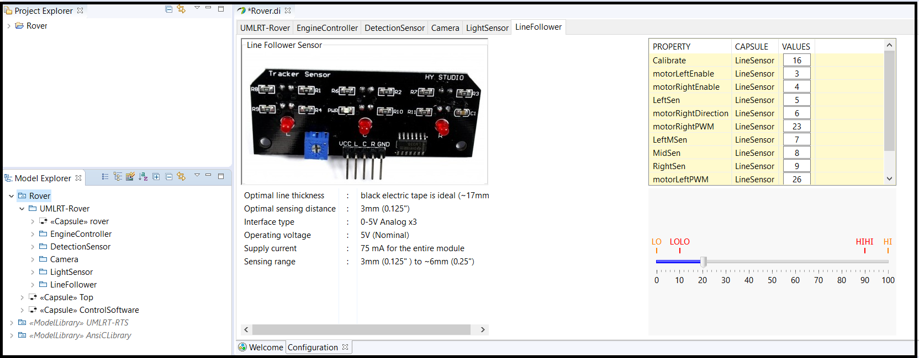
Current Implementation – Expert Mode

Slide 10
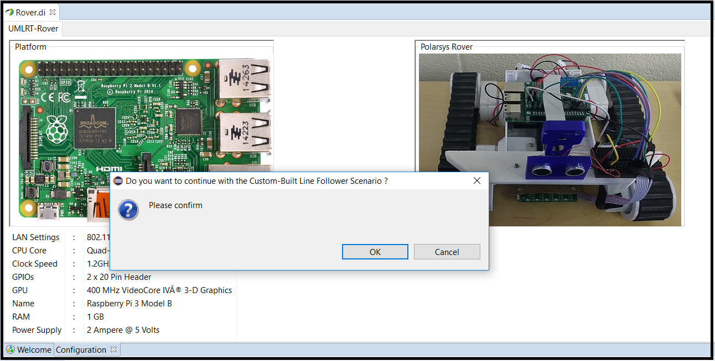
Current Implementation – Beginner Mode

Slide 11
Future Work
Extending the concept of Configuration pages to more than run-time configurations, and to include some compile time customizations
Detailed analysing of the Rover Case Study to define a feature models for the same

Slide 12
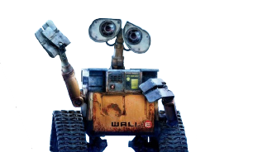
Thank You !!

